Slide 1
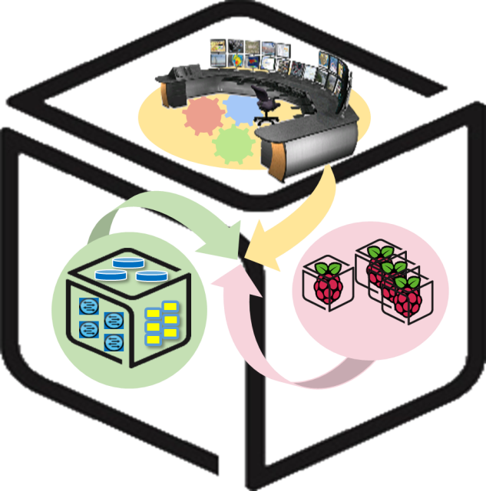
SmartX Labs for computer systems
WebApp Lab
version 1.0

Slide 2
History and Contributor of Box Lab
(2016. 05. 22)
Version | Updated Date | Updated Contents | Contributor
 |  |  | Lucas
V1.0 | 2016-05-22 |  | 이준기

Slide 3
웹 서버 프로그래밍
Node.js 이전 (e.g LAMP)
Node.js 사용
Web Browser
Web
Server
(Daemon/
Service)
Server-side Script
(JSP, PHP, ASP, …)
Database
Web Browser
Web Browser
Web Browser
Client-side Script
(Java Script)
Client-side Script
(Java Script)
Client-side Script
(Java Script)
Client-side Script
(Java Script)
Web Browser
Server-side JavaScript
(Node.js)
Database
Web Browser
Web Browser
Web Browser
Client-side Script
(Java Script)
Client-side Script
(Java Script)
Client-side Script
(Java Script)
Client-side Script
(Java Script)

Slide 4
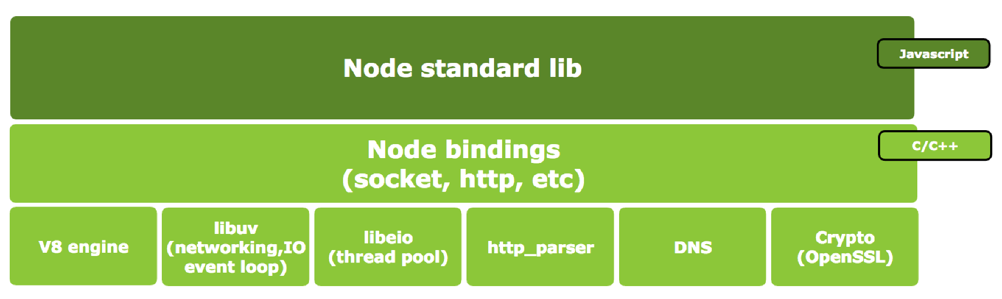
Node.js Architecture

Slide 5
Node.js Pros and Cons
장점
Server-side JavaScript → 높은 생산성
Single thread, non-block I/O → 가볍고 빠름
I/O 직접수행 안 함 → 프로세스 Block되지 않음
단점
Single thread → 멀티코어 CPU 효율을 위해 여러 개의 프로세스를 사용해야 하고, 어떤 한 작업이 무거우면 전체 성능이 저하될 수 있음
Event Callback → 중첩될 경우 가독성 급격히 저하 (callback hell)
V8 engine → Garbage Collection기반 메모리관리로 순간적인 CPU 사용률 상승 가능성 있고, 이는 서버 안정성 저하

Slide 6
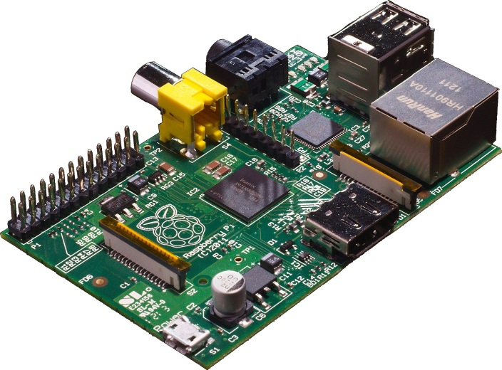
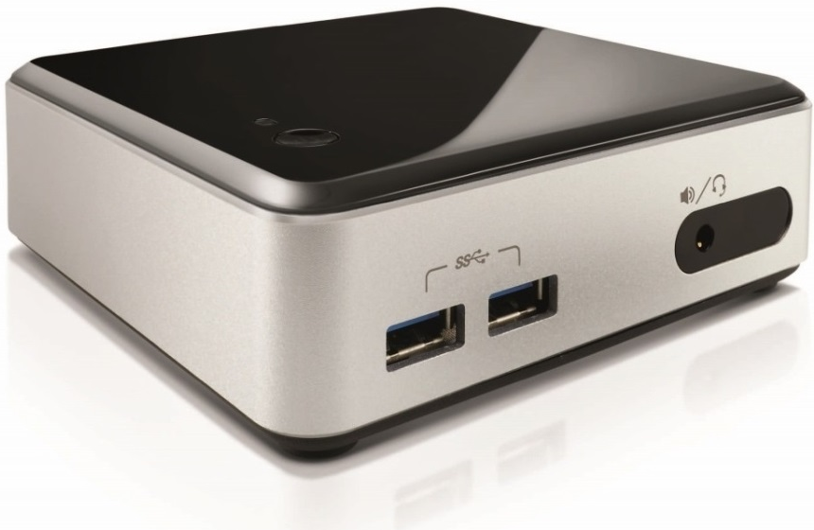
개발환경 구축
Node.js 설치 (Ubuntu 14.04)
$ sudo apt-get update
$ sudo apt-get install nodejs npm
OS: Ubuntu 14.04
Web-Server: Node.js
HTTP Request
HTTP Response
<Web Client>
<Web Server>

Slide 7
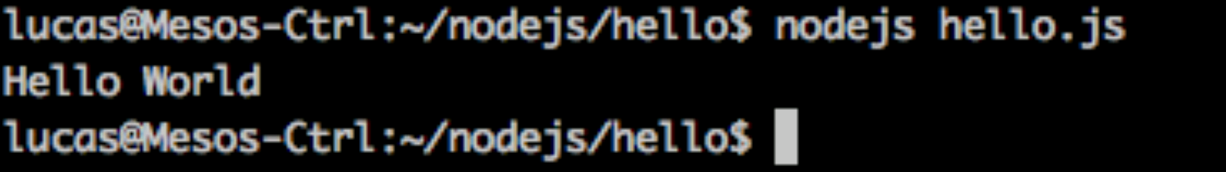
Hello World
Ex) vim hello.js
How to run?
$ nodejs hello.js
console.log('Hello World');

Slide 8

Nodeclipse “Enide 2015” : Node.js development on Ubuntu
Install JAVA JDK 8
$ sudo add-apt-repository ppa:webupd8team/java
$ sudo apt-get update
$ sudo apt-get install oracle-java8-installer

Slide 9
Nodeclipse “Enide 2015” : Node.js development on Ubuntu
Install nodeclipse
Download Nodeclipse “Enide 2015”
https://sourceforge.net/projects/nodeclipse/files/Enide-2015/7/Enide-2015-7-linux-gtk-x64-20150706.zip/download
Extract to folder
$ sudo nautilus ~/Downloads sudo nautilus /opt
$ cd chmod –R 7555 eclipse
$ sudo gedit /usr/share/applications/enide-2015-7.desktop

Slide 10
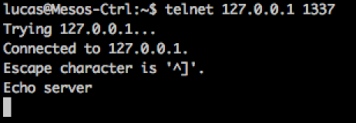
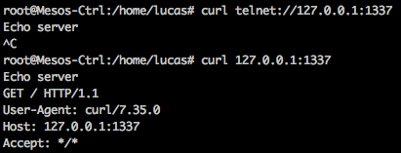
Simple TCP Server
var net = require('net');
var server = net.createServer(function (socket) {
socket.write('Echo server\r\n');
socket.pipe(socket);
});
server.listen(1337);
<Client>

Slide 11


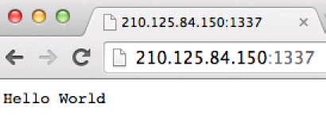
Simple Web Server
var http = require('http');
http.createServer(function (req, res) {
res.writeHead(200, {'Content-Type': 'text/plain'});
res.end('Hello World\n');
}).listen(1337);
console.log('Server running at port 1337/');
<Server>
<Client>

Slide 12
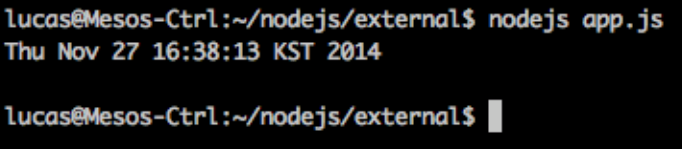
External File Execution (Simple)
var exec = require('child_process').exec;
exec("date", function (error, stdout, stderr) {
console.log(stdout);
});

Slide 13
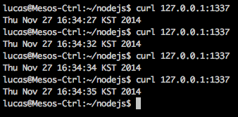
External File Execution (Web)
var http = require('http'),
exec = require('child_process').exec;
http.createServer(function (req, res) {
res.writeHead(200, {'Content-Type': 'text/plain'});
exec("date", function (error, stdout, stderr) {res.end(stdout)} );
}).listen(1337);
console.log('Server running');

Slide 14
Node Packaged Module(NPM)
Node.js로 만들어진 모듈 관리자
Ubuntu의 APT와 유사하다
패키지 설치
npm install <package name>
Global install: 패키지를 /usr/local/lib에 설치, 패키지에 따라 Global로 설치해야 하는 것이 있다.
Local install: 패키지를 현재 폴더 내에 설치하고, 폴더내의 파일에서만 불러올 수 있다.

Slide 15
File Upload (1/4)
패키지 설치:npm install formidable fs-extra
var formidable = require('formidable'),
http = require('http'),
util = require('util'),
fs = require('fs-extra');
http.createServer(function(req, res) {
/* Process the form uploads */
if (req.url == '/upload' && req.method.toLowerCase() == 'post') {
var form = new formidable.IncomingForm();
form.parse(req, function(err, fields, files) {
res.writeHead(200, {'content-type': 'text/plain'});
res.write('received upload:\n\n');
res.end(util.inspect({fields: fields, files: files}));
});

Slide 16
File Upload (2/4)
form.on('progress', function(bytesReceived, bytesExpected) {
var percent_complete = (bytesReceived / bytesExpected) * 100;
console.log(percent_complete.toFixed(2));
});
form.on('error', function(err) {
console.error(err);
});
form.on('end', function(fields, files) {
/* Temporary location of our uploaded file */
var temp_path = this.openedFiles[0].path;
/* The file name of the uploaded file */
var file_name = this.openedFiles[0].name;
/* Location where we want to copy the uploaded file */
var new_location = process.env.PWD + '/';

Slide 17
File Upload (3/4)
fs.copy(temp_path, new_location + file_name, function(err) {
if (err) {
console.error(err);
} else {
console.log("success!")
}
});
});
return;
}
/* Display the file upload form. */
res.writeHead(200, {'content-type': 'text/html'});
res.end(

Slide 18
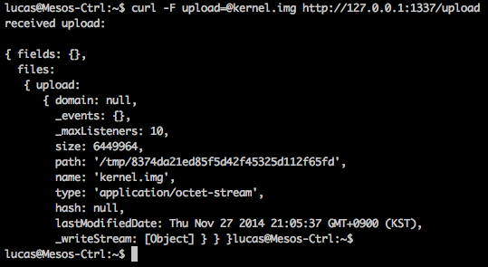
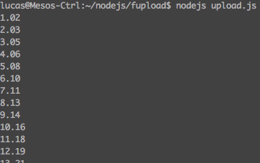
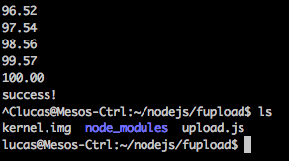
File Upload (4/4)
'<form action="/upload" enctype="multipart/form-data" method="post">'+
'<input type="text" name="title"><br>'+
'<input type="file" name="upload" multiple="multiple"><br>'+
'<input type="submit" value="Upload">'+
'</form>'
);
}).listen(1337);

Slide 19
Express Framework
Node.js web application framework
설치: npm install express
설치된 패키지 목록: npm ls or npm –g ls

Slide 20


Web Server using Express
var express = require('express')
, http = require('http')
, app = express()
, server = http.createServer(app);
app.get('/', function (req, res) {
res.send('Hello /\n');
});
app.get('/world.html', function (req, res) {
res.send('Hello World\n');
});
server.listen(8888, function() {
console.log('Express server listening on port ' + server.address().port);
});

Slide 21
Template Engine: Embedded JavaScript (for Dynamic Web Page)
패키지 설치 (전역)
sudo npm install -g express-generator
환경변수 설정
export NODE_PATH=/usr/local/lib/node_modules
작업폴더 생성 및 이동
mkdir ejs
cd ejs
스크립트 수정
sudo vim /usr/local/lib/node_modules/express-generator/bin/express
첫행의 node → nodejs로 수정 후 저장
관련 패키지 환경설정
/usr/local/lib/node_modules/express-generator/bin/express -e 실행
의존 패키지 설치
npm install

Slide 22
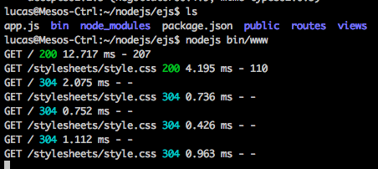
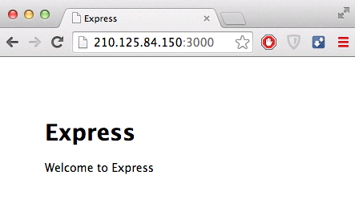
Template Engine: Embedded JavaScript (for Dynamic Web Page)
템플릿 설치 확인과 웹서버 앱 실행

Slide 23
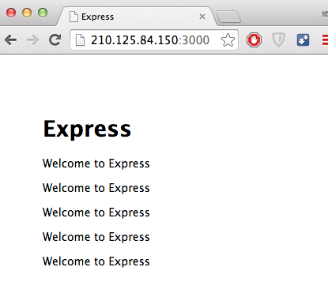
Template Engine: Embedded JavaScript (for Dynamic Web Page)
텍스트 반복출력 실습 (코드 수정)
vim views/index.ejs
nodejs bin/www
<!DOCTYPE html>
<html>
<head>
<title><%= title %></title>
<link rel='stylesheet' href='/stylesheets/style.css' />
</head>
<body>
<h1><%= title %></h1>
<% for (var i = 0; i < 5; i++) { %>
<p>Welcome to <%= title %></p>
<% } %>
</body>
</html>

Slide 24




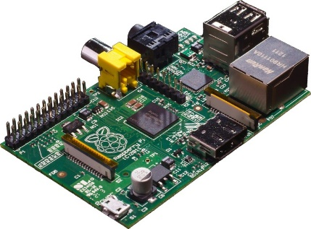

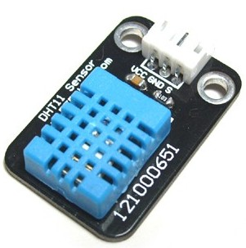
Architecture of WebApp

Slide 25
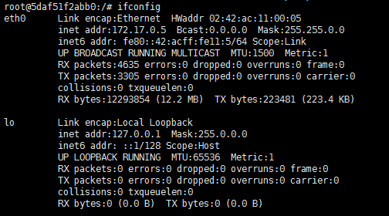
Create Docker Container for nodejs WebApp
$ sudo docker run –it –-net=host --name=webapp ubuntu /bin/bash
# apt-get update
# apt-get install net-tools
# apt-get install iputils-ping

Slide 26


Install node.js in Docker Container
# apt-get install nodejs
(# apt-get install nano)
Test
# nano test.js
# nodejs test.js

Slide 27
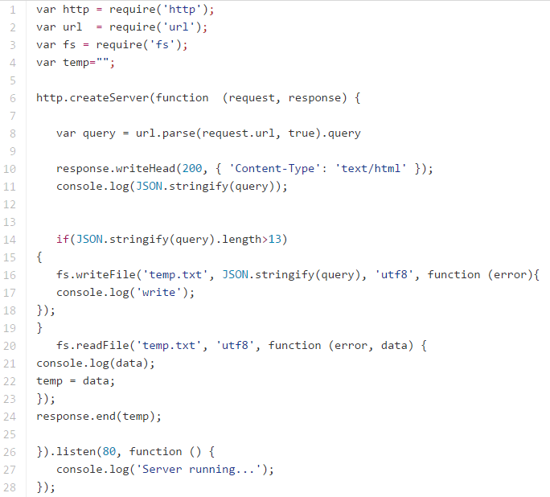
nodejs WebApp code
# nano webapp.js

Slide 28
nodejs WebApp code
# nodejs webapp.js
At the NUC, Open browser and goto
http://<IP_of_NUC>

Slide 29
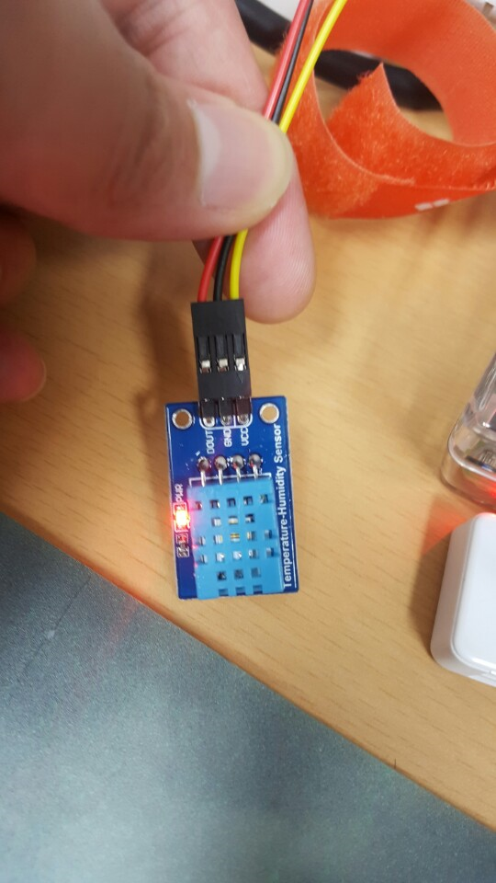
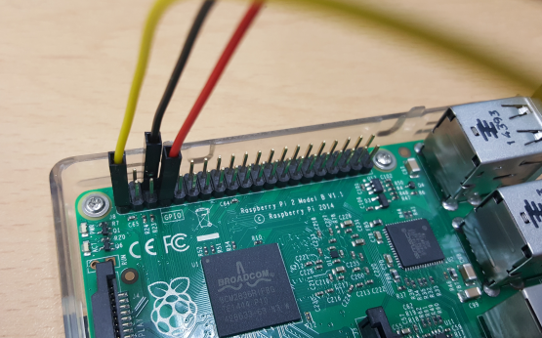
WebApp with RPi sensor
http://www.uugear.com/portfolio/dht11-humidity-temperature-sensor-module/

Slide 30

WebApp with RPi sensor
Install dependencies at RPi
$ sudo apt-get update
$ sudo apt-get install python-pip
$ sudo apt-get install libpython2.7-dev python-numpy
$ sudo pip install RPi.GPIO
$ sudo apt-get install mercurial

Slide 31
WebApp with RPi sensor
Temperature sensor code
$ sudo nano RPI_temp.py
Copy code from
https://github.com/2jungi/SmartX-Mini/blob/master/RPI_temp.py

Slide 32


Revise code for WebApp
Change IP address to <Your NUC’s IP>
sudo python RPI_temp.py

Slide 33
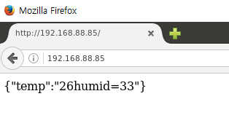
WebApp in Browser
At the Docker container in NUC
# nodejs webapp.js
At the NUC or DevTower
Open Web browser and goto http://<IP_of_NUC>
At the RPi
$ sudo python RPI_temp.py

Slide 34
References
http://nodejs.org/
http://expressjs.com
http://pyrasis.com/nodejs/nodejs-HOWTO
http://www.codediesel.com/nodejs/processing-file-uploads-in-node-js/
http://www.gliffy.com/publish/2752090/
http://kipid.tistory.com/entry/Learning-Nodejs
http://www.nodeclipse.org/ubuntu/linux/java/nodejs/2015/2015/07/09/Starting-with-Java-and-Node.js-development-on-Ubuntu-Linux.html

